Slide 1
STEVENS INSTITUTE OF TECHNOLOGY
EE-695 APPLIED MACHINE LEARNING
GRADUATE ADMISSION PREDICTION USING PREDICTIVE MODELLING USING ML ALGORITHM
Tanvi Venkatesh tvenkat2@stevens.edu
Jessica Kamman
jkamman@stevens.edu
Priyank Sanghvi
psanghv1@stevens.edu

Slide 2
ABSTRACT
A model that predicts a student's odds of being admitted to a certain institution.
Takes into account a variety of student-related factors in order to apply for their MS.
Use of data related to previous applicants to various universities and their admit or reject status.

Slide 3
REASON TO PURSUE THIS PROJECT
Young employees who want to make a name for themselves in the workplace are always on the lookout for higher degrees that may help them advance their abilities and knowledge.
This reality has prompted us to research student grades and the probability of admission to master's programmes.

Slide 4
INTRODUCTION
This model was developed to forecast the progress of prospective students by comparing the score of students currently studying at university.
Inspecting feature values that help identify what needs to be done to clean or pre-process until you see the range or distribution of values typical of each attribute.
Then, machine learning techniques like logistic regression, decision tree random forest algorithm are used.

Slide 5
PROPOSED SYSTEM
Considering all the factors to make up the profile for graduation admission such as, GRE, IELTS/TOEFL, SOP, LOR, UG score, Research papers, job experience, internship, extra curricular, projects, and achievements.
The dataset will have lot of anomalies like missing values, outliers and so on. Hence, missing value treatment, outlier treatment, feature engineering and EDA will be done efficiently.
EDA helps to get a clear idea about our features. It also helps us capture any trend or seasonality of data points.

Slide 6
ALGORITHMS USED
Random Forest
Logistic Regression
Decision Tree

Slide 7
Random Forest
A random forest is a machine learning technique that’s used to solve regression and classification problems. It utilizes ensemble learning, which is a technique that combines many classifiers to provide solutions to complex problems.
Logistic Regression
Logistic Regression was used in the biological sciences in early twentieth century. It was then used in many social science applications. Logistic Regression is used when the dependent variable(target) is categorical.

Slide 8
Decision Tree
A decision tree is a decision support hierarchical model that uses a tree-like model of decisions and their possible consequences, including chance event outcomes, resource costs, and utility. It is one way to display an algorithm that only contains conditional control statements.
Decision trees are commonly used in operations research, specifically in decision analysis, to help identify a strategy most likely to reach a goal, but are also a popular tool in machine learning.

Slide 9
MODULES
Module 1: Data reading and uploading
Module 2: Data pre-processing
Module 3: Plotting of data visually
Module 4: Training and splitting of data
Module 5: Models and prediction
Module 6: Comparison of algorithm

Slide 10
Module 1: Data reading and uploading
First uploading data set into collab and then creating a folder for the data set and workspace.
Module 2: Data pre-processing
To, clean the data we first need to see if any
null values are present,
find the data type,
draw irrelevant columns.

Slide 11
Module 3: Plotting of data visually
In order to get into depth of the data to get the best of the prediction, graphs and plots can be drawn. Here, the chance of admit is compared to every aspect of students profile and presented graphically.
Module 4: Training and splitting of data
This data set consists of 400 rows, and we split the data dependent and independent variables. And further split into train and test sets 80% of data for training and 20% for testing.

Slide 12
Module 5: Models and prediction
Using random forest algorithm, decision tree and logistic regression, we predict the scores of the data in X test.
Then display the predicted scores, and then compare the actual and predicted scores.
Module 6: Comparison of algorithm
Here we compare random forest and logistic regression to understand the difference of the accuracy and why random forest is better suitable with the help of its accuracy and heat maps.

Slide 13
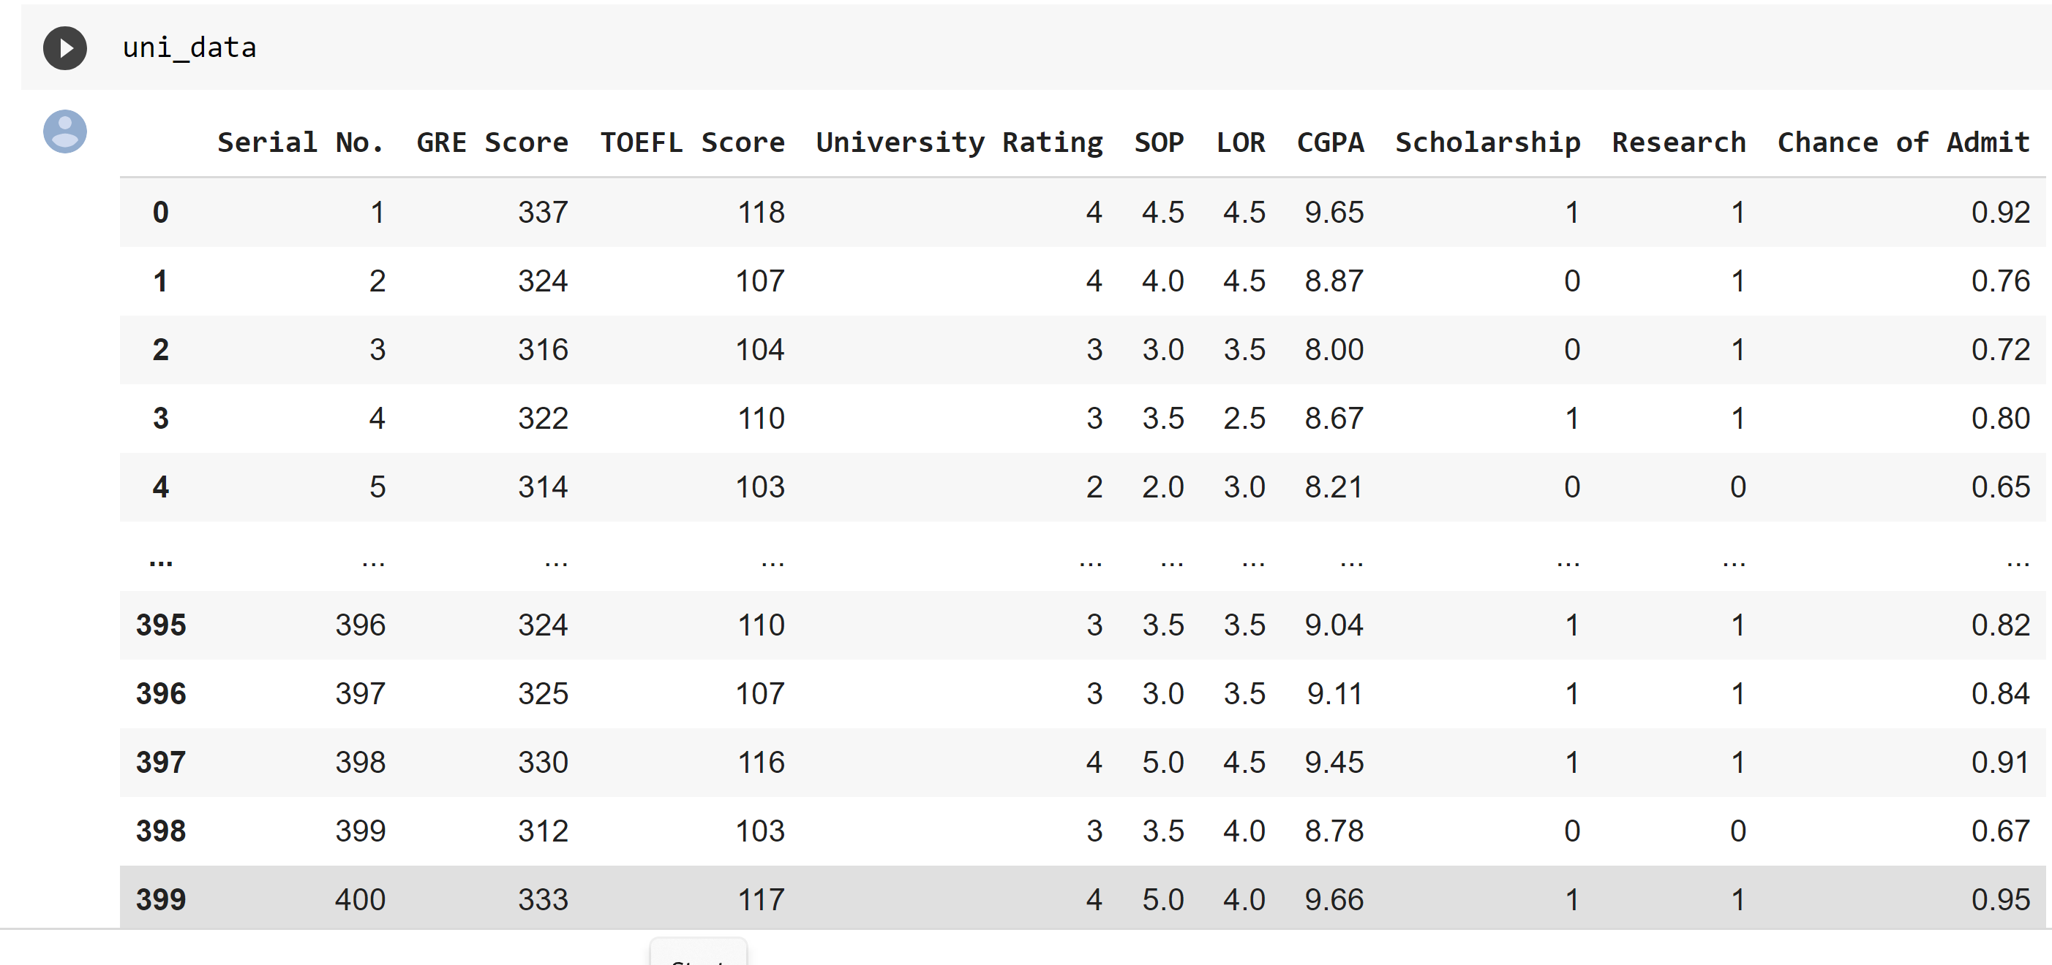
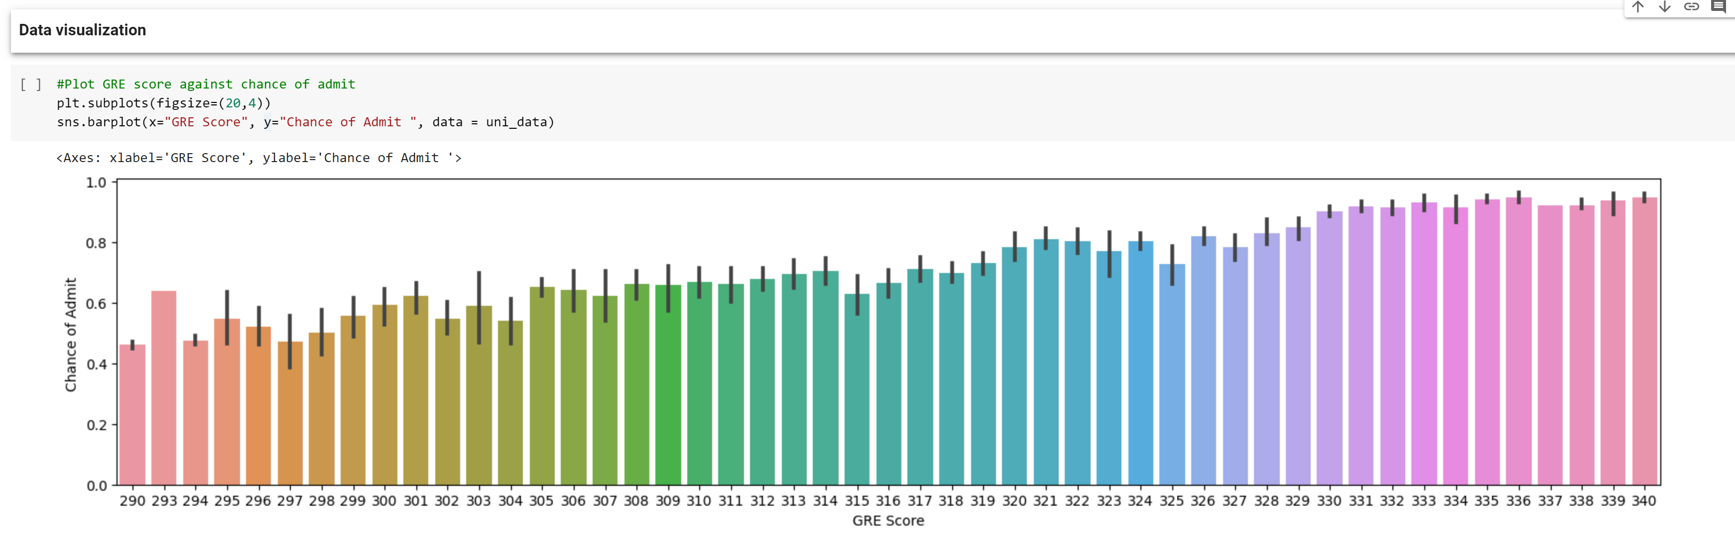
Data head
Visualization

Slide 14
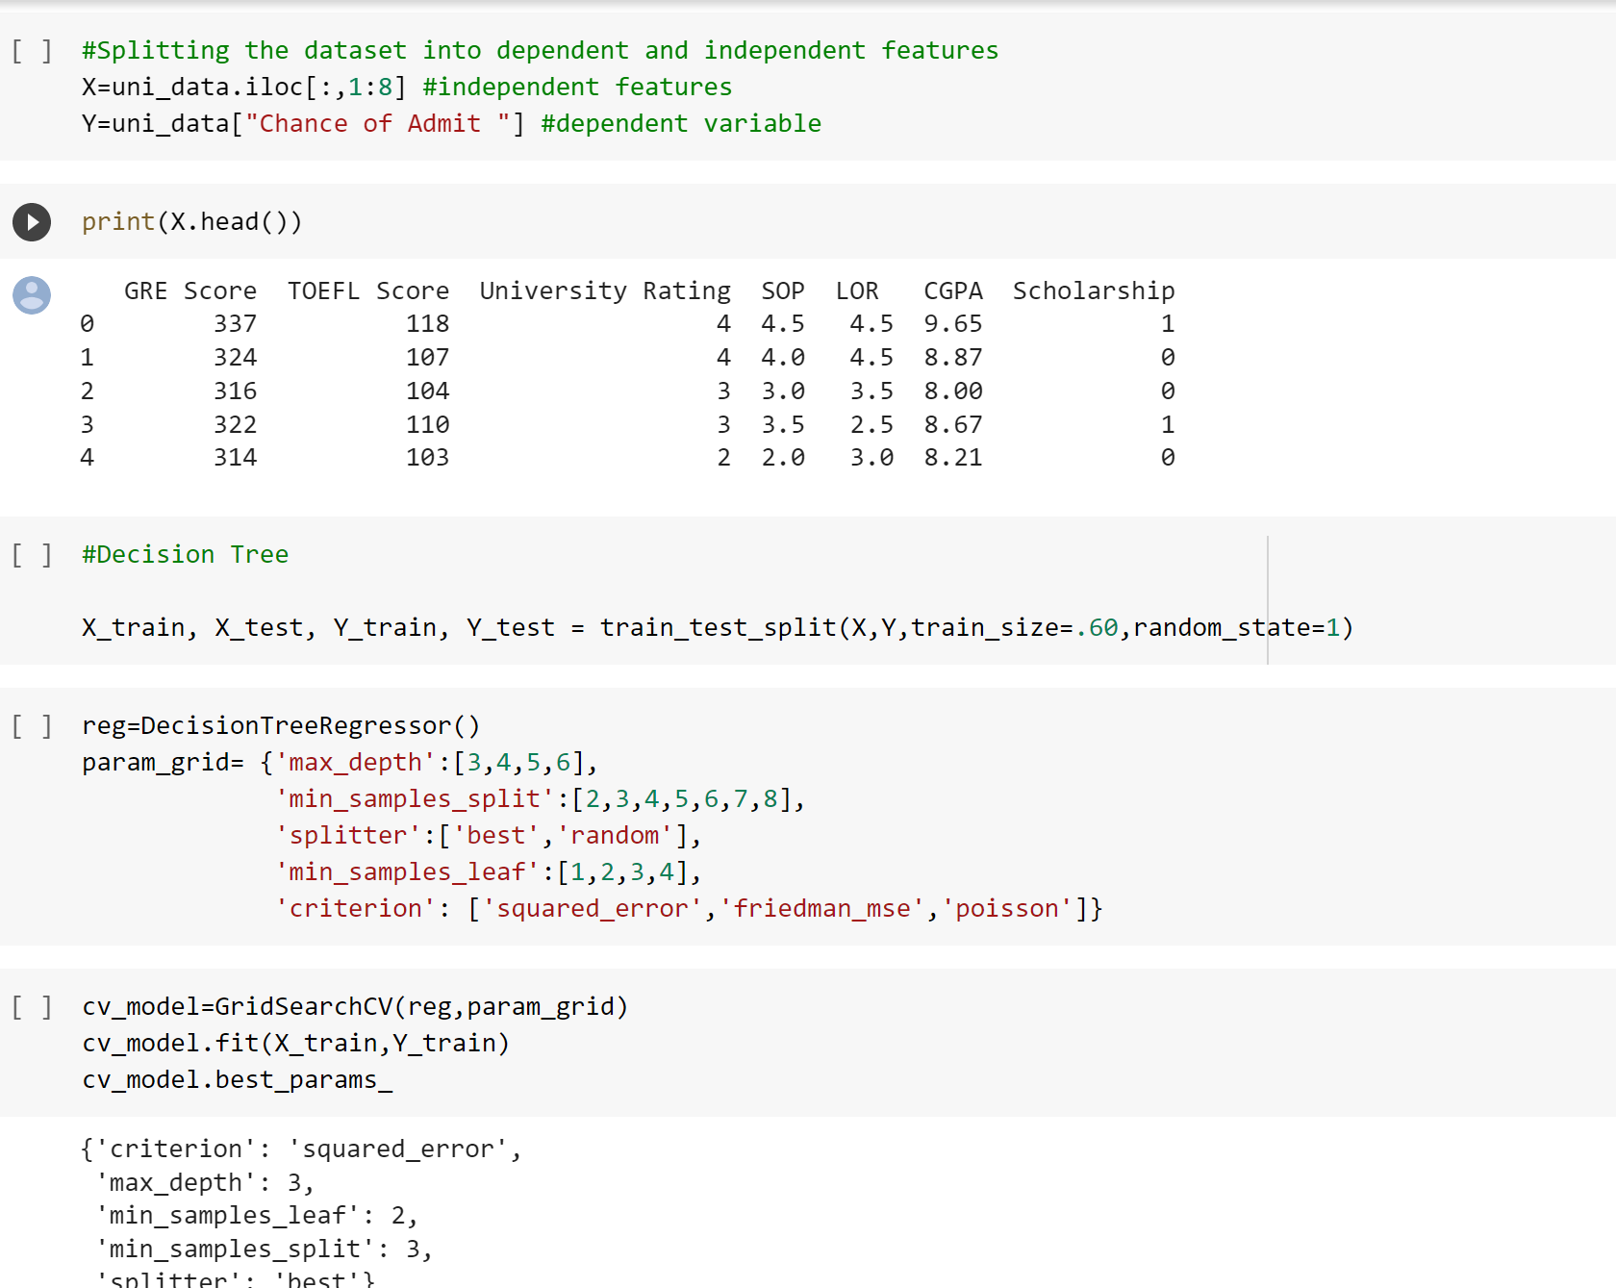
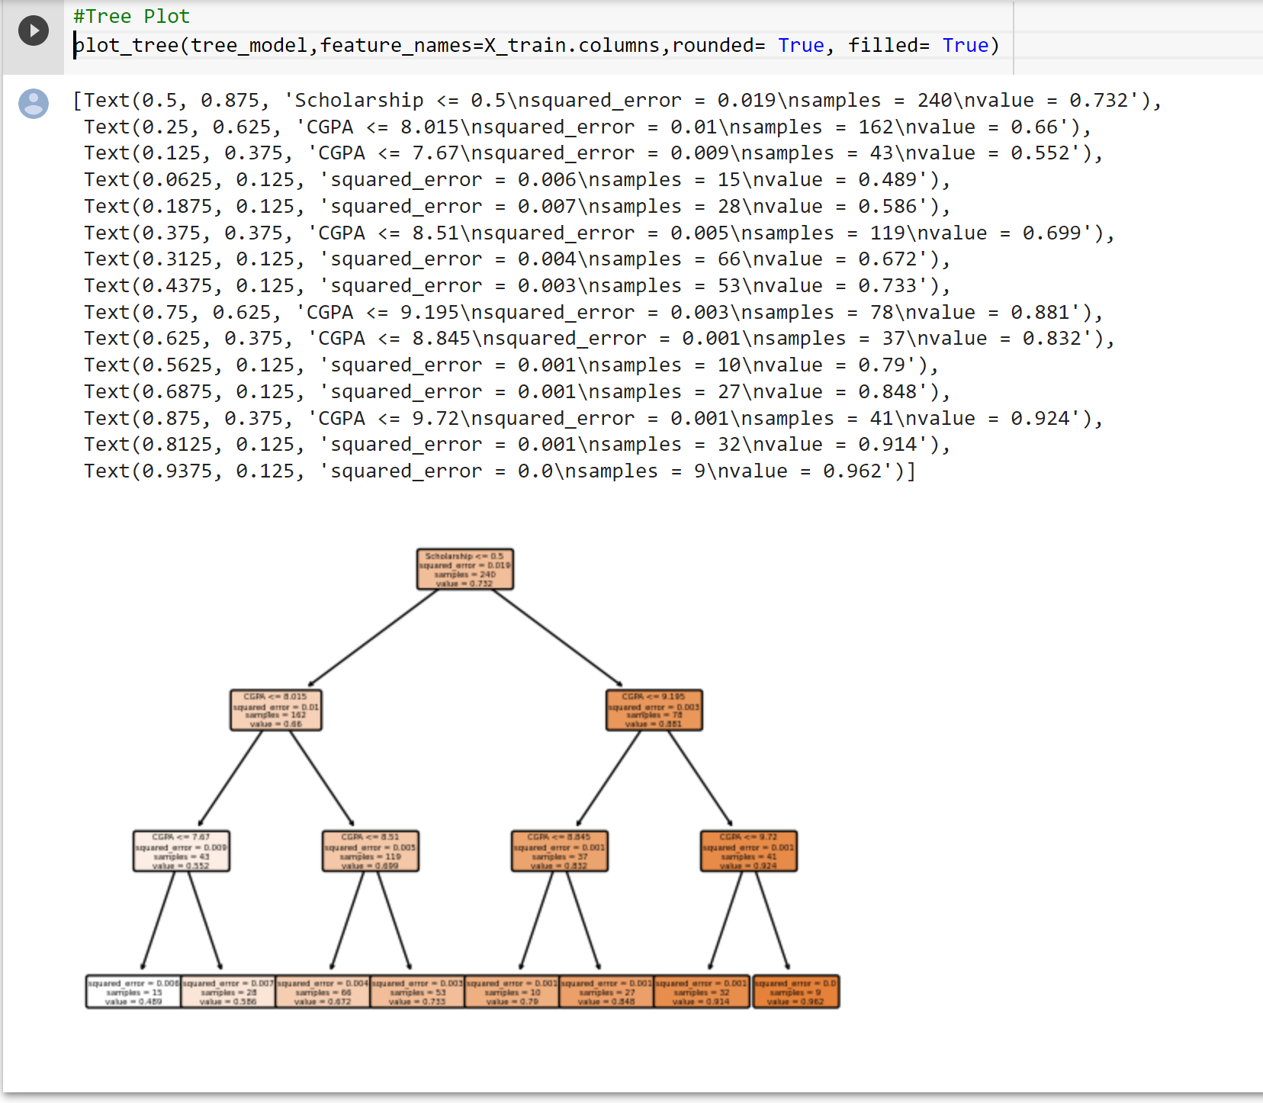
Decision tree

Slide 15
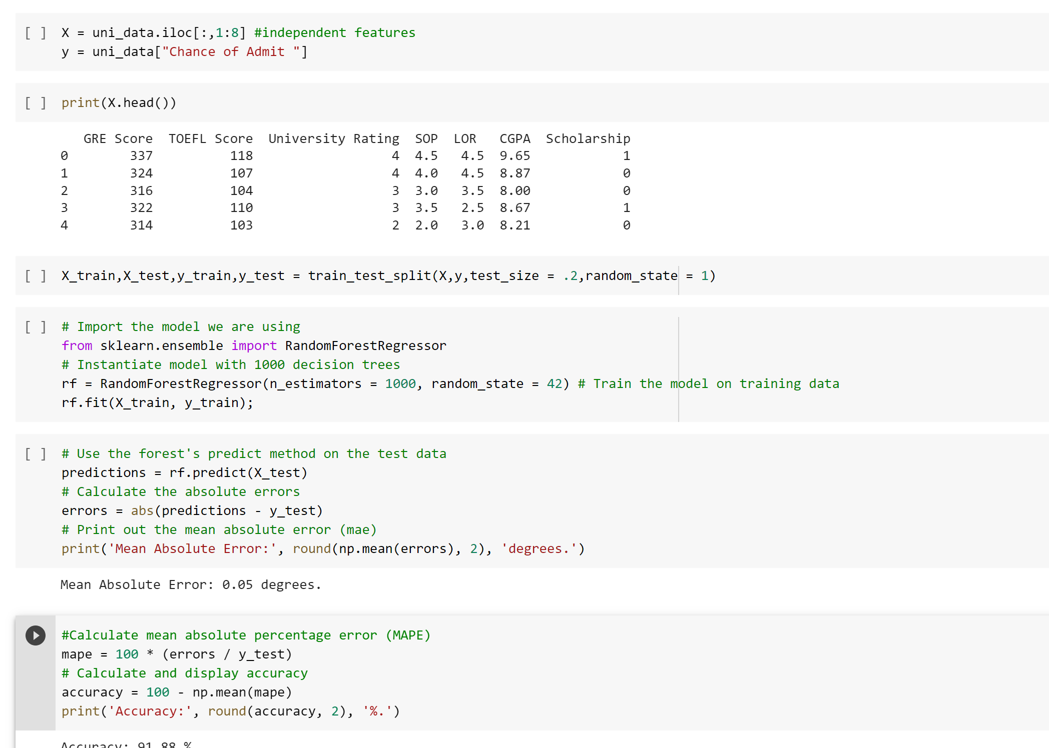
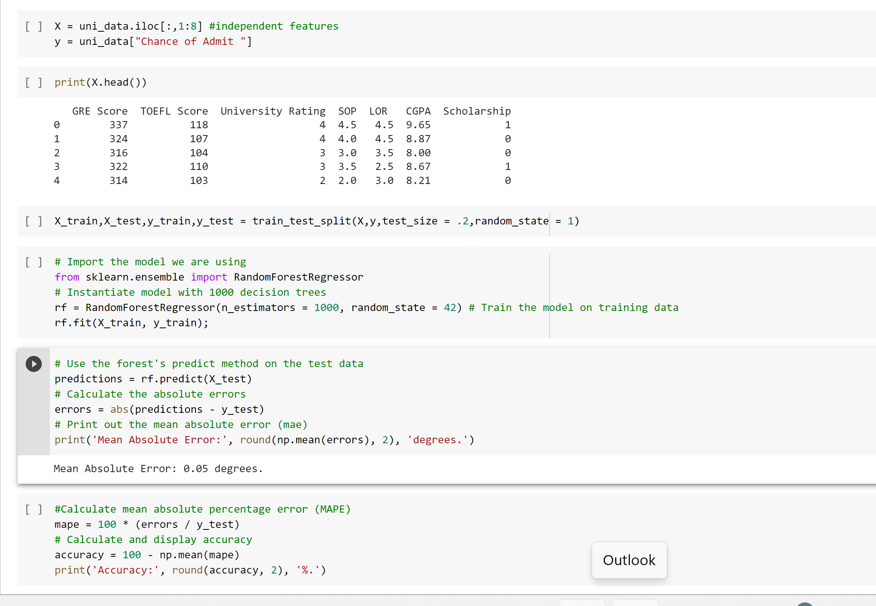
Random Forest

Slide 16
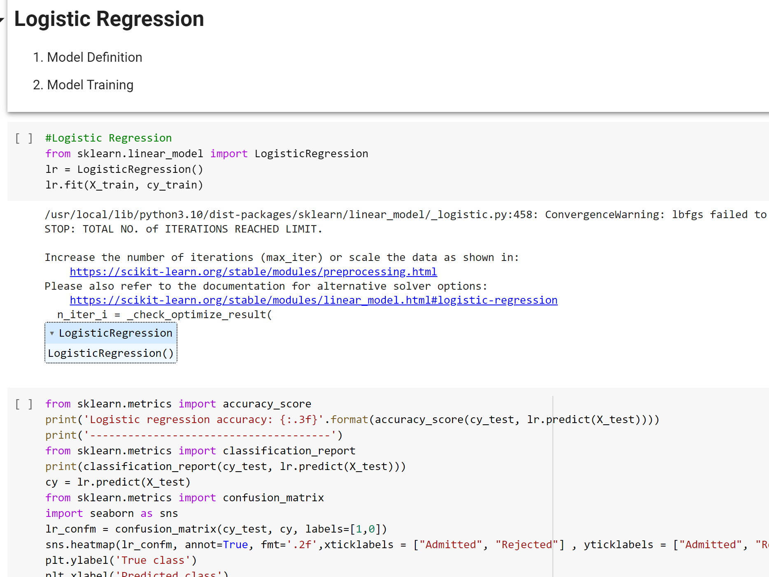
Logistic Regression

Slide 17
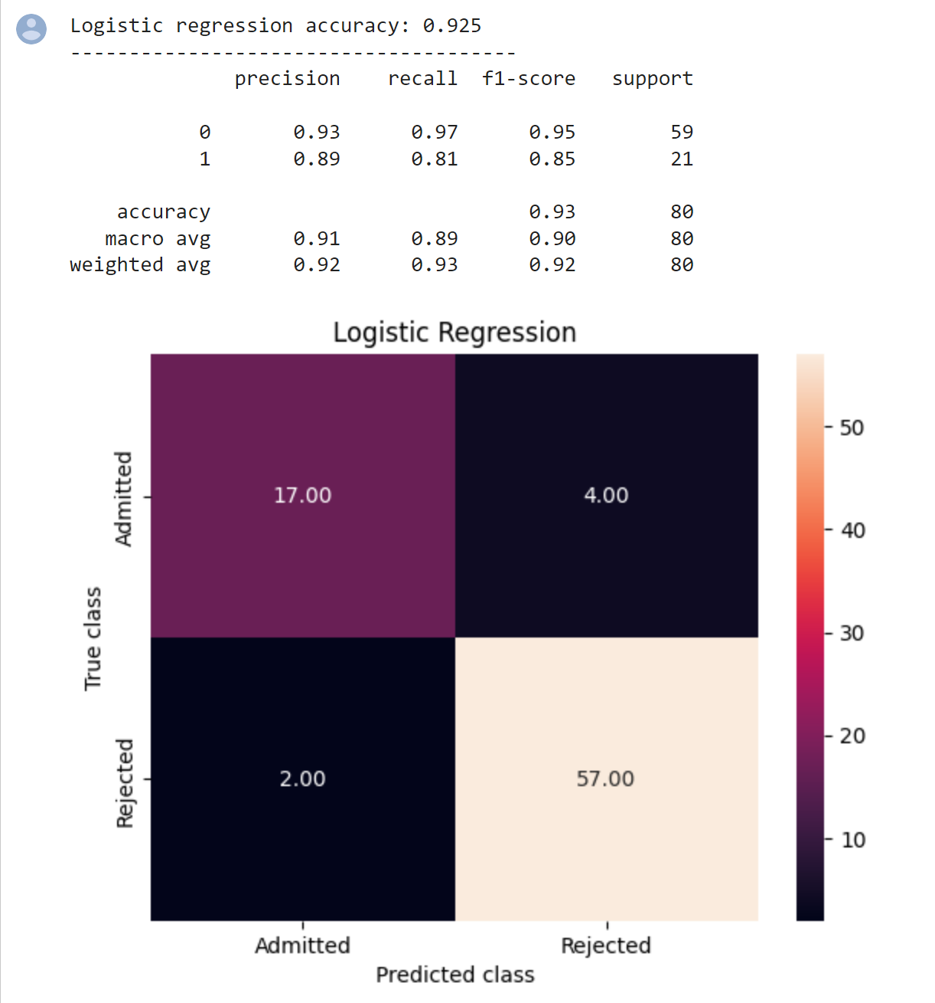
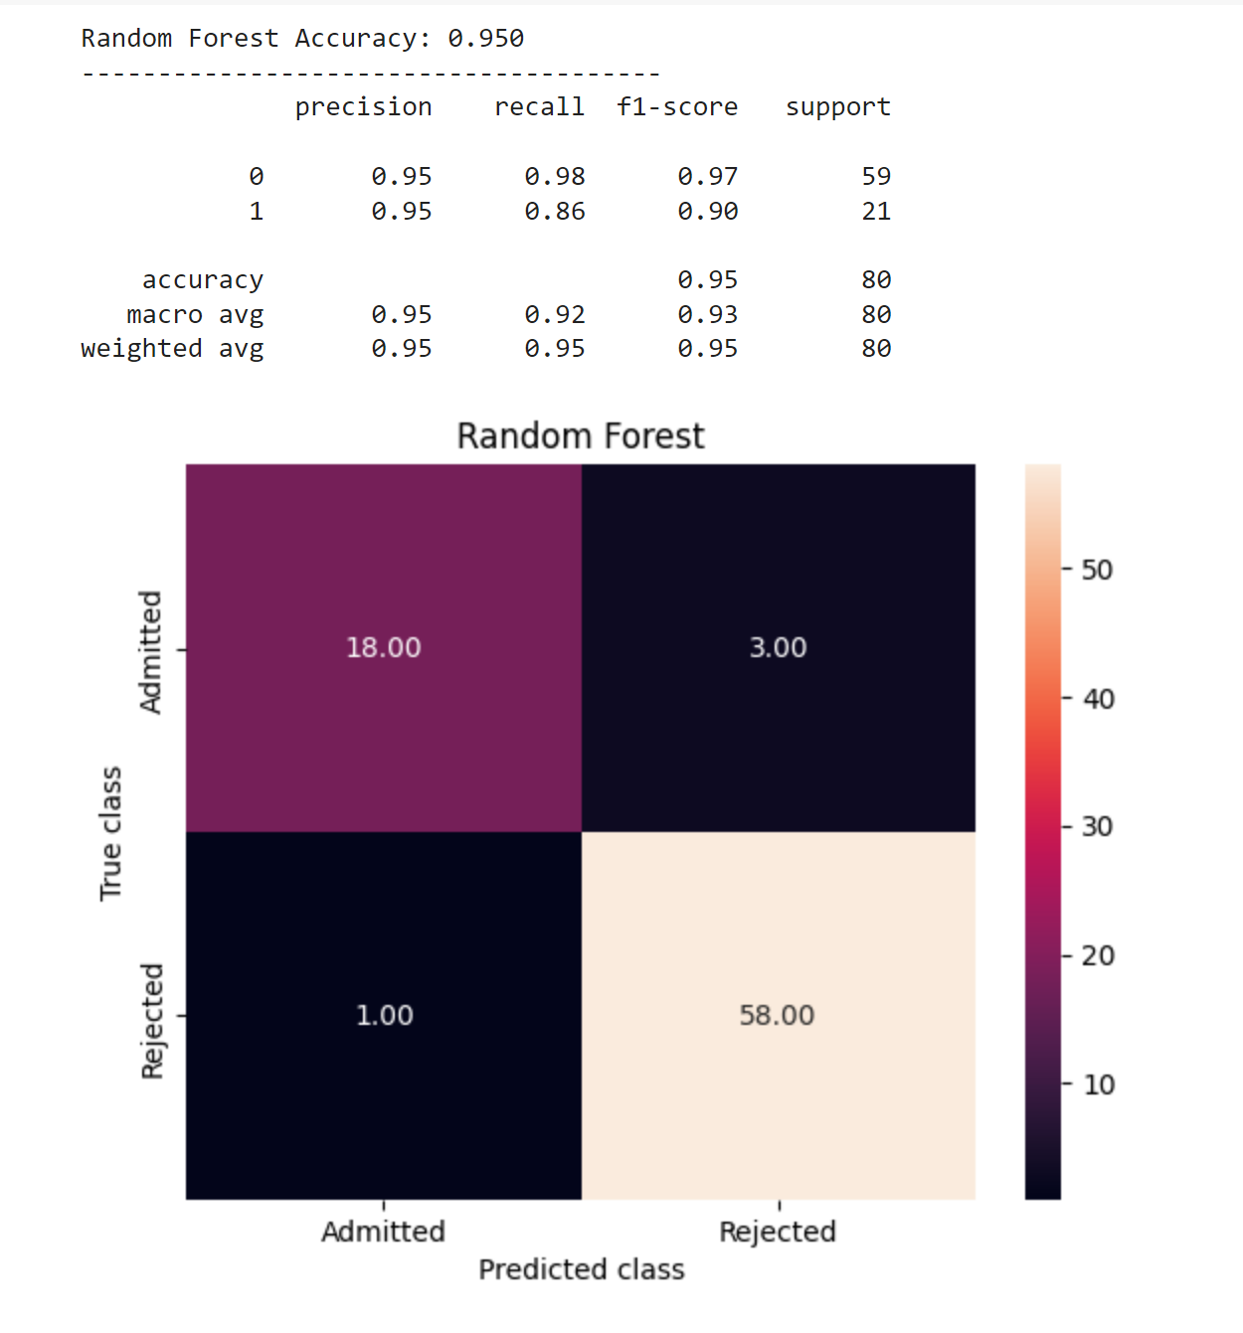
Comparing Models

Slide 18
CONCLUSION
Students can use the model to assess their chances of getting admission into a particular university with an average accuracy of 95 percent.
The ultimate goal of research will be accomplished successfully, as the system allows students to save the lot of time and money that they would spend on educational mentors and application fees for colleges where they have less chances of getting admissions.

Slide 19
REFRENCES
N. Gupta, A. Sawhney, and D. Roth, “Will i Get in? Modeling the Graduate Admission Process for American Universities,” IEEE Int. Conf. Data Min. Work. ICDMW, vol. 0, pp. 631–638, 2016.
A. Waters and R. Miikkulainen, “GRADE : Graduate Admissions,” pp. 64–75, 2014.
S. Sujay, “Supervised Machine Learning Modelling & Analysis for Graduate Admission Prediction,” vol. 7, no. 4, pp. 5–7, 2020.
F. Salo, M. Injadat, A. Moubayed, A. B. Nassif, and A. Essex, “Clustering Enabled Classification using Ensemble Feature Selection for Intrusion Detection,” in 2019 International Conference on Computing, Networking and Communications (ICNC), 2019, pp. 276–281
A. Moubayed, M. Injadat, A. B. Nassif, H. Lutfiyya, and A. Shami, “E-Learning: Challenges and Research Opportunities Using Machine Learning Data Analytics,” IEEE Access, 2018
https://www.kaggle.com/datasets/mohansacharya/graduate-admissions

Slide 20
Zoom Link
https://stevens.zoom.us/rec/share/dY-jWNYTOayoYNJlspgh8xxkJiAV7WSVv0RAEGZ6NkGo5TInicRDa4oHVbPuv1AH.w1t0h8hDotLIX6kB?startTime=1683753636000

